Slide 1
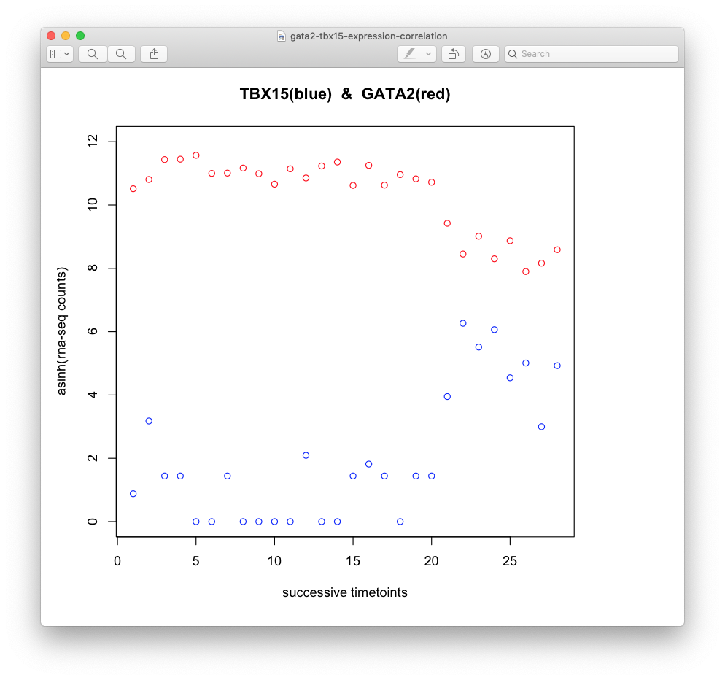
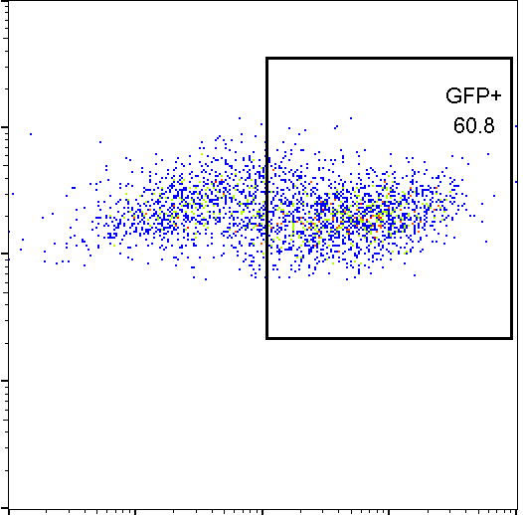
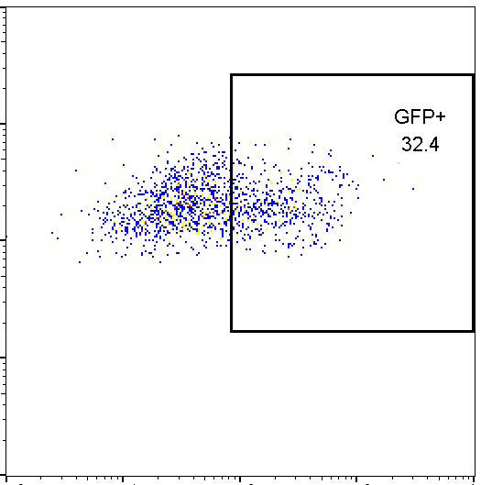
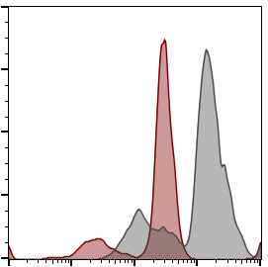
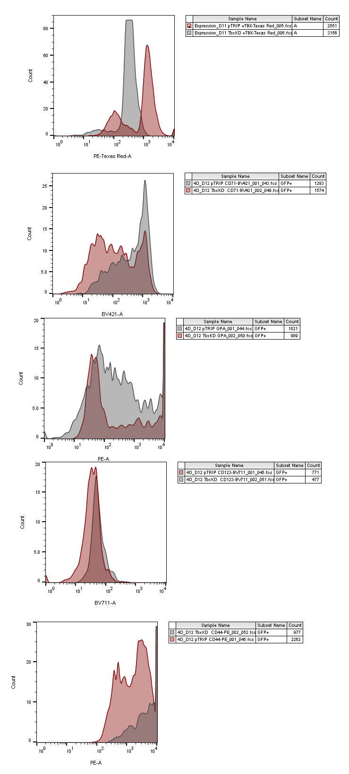
A
TRENA result suggesting TBX15 is an important
Regulator of the proEB to EB transition
?
B
C
Lentivirus infection
(GFP and shTBX15)
Control
(GFP only)
Knockdown
(GFP and shTBX15)
10⁴
10⁴
Days
10³
10³
0
8
9
11
12
20
SSC-A
10²
10²
proEB
EB
10¹
10¹
GFP⁺ selection
& analysis
10⁰
10⁰
10⁰
10¹
10²
10³
10⁴
10⁰
10¹
10²
10³
GFP
GFP
10⁴
D
E
TBX15
CD71
GPA
80
Control
80
80
Ctrl
60
shTBX15
60
60
shTBX15
40
Count
40
40
20
Count
Count
10
20
20
0
10
10
10⁰
0
0
10¹
10²
10³
10⁴
10⁰
10¹
10²
10³
10⁰
10⁴
10¹
10²
10³
10⁴
MFI
MFI
MFI
Figure X: The transcription factor TBX15 is an important regulator of the pro-erythroblast (proEB) to erythroblast (EB)
transition.
TRENA model predicts that TBX15 regulates the proEB to EB transition through binding to key regulatory genes.
ProEB were infected with lentiviruses expressing GFP and a TBX15-specific shRNA or only GFP (as a control).
Cells at Day12 were harvested and gated by FACS to separate infected (GFP-positive) and non-infected (GFP-negative)
cells (C). (D) GFP-positive cells display a strong knockdown of TBX15. (E) Erythroid cells with reduced levels of TBX15
do not upregulate erythroid-specific cell surface markers CD71 and GPA, suggesting a block at the proEB stage.
MFI, mean fluorescence intensity.

Slide 2
TBX15 ChIP – Day11 Ery cells
1st Nov 2019
Site 1
Site 2
Site 3
Site 4
IP/Input
4 regions de putative binding for TBX15 close to the GATA2 gene:
1: chr3:128,483,003-128,483,009 Hsapiens-jaspar2018-TBX15-MA0803.1 chr3 + 6.642737 0.8767398 AGGGGTGA
2: chr3:128,483,452-128,483,457 Hsapiens-jaspar2018-TBX15-MA0803.1 chr3 + 6.658030 0.8787582 CGGTGTGA
3: chr3:128,486,956-128,486,962 Hsapiens-jaspar2018-TBX15-MA0803.1 chr3 + 6.658030 0.8787582 CGGTGTGA
4: chr3:128,497,528-128,497,534

